Slide 1
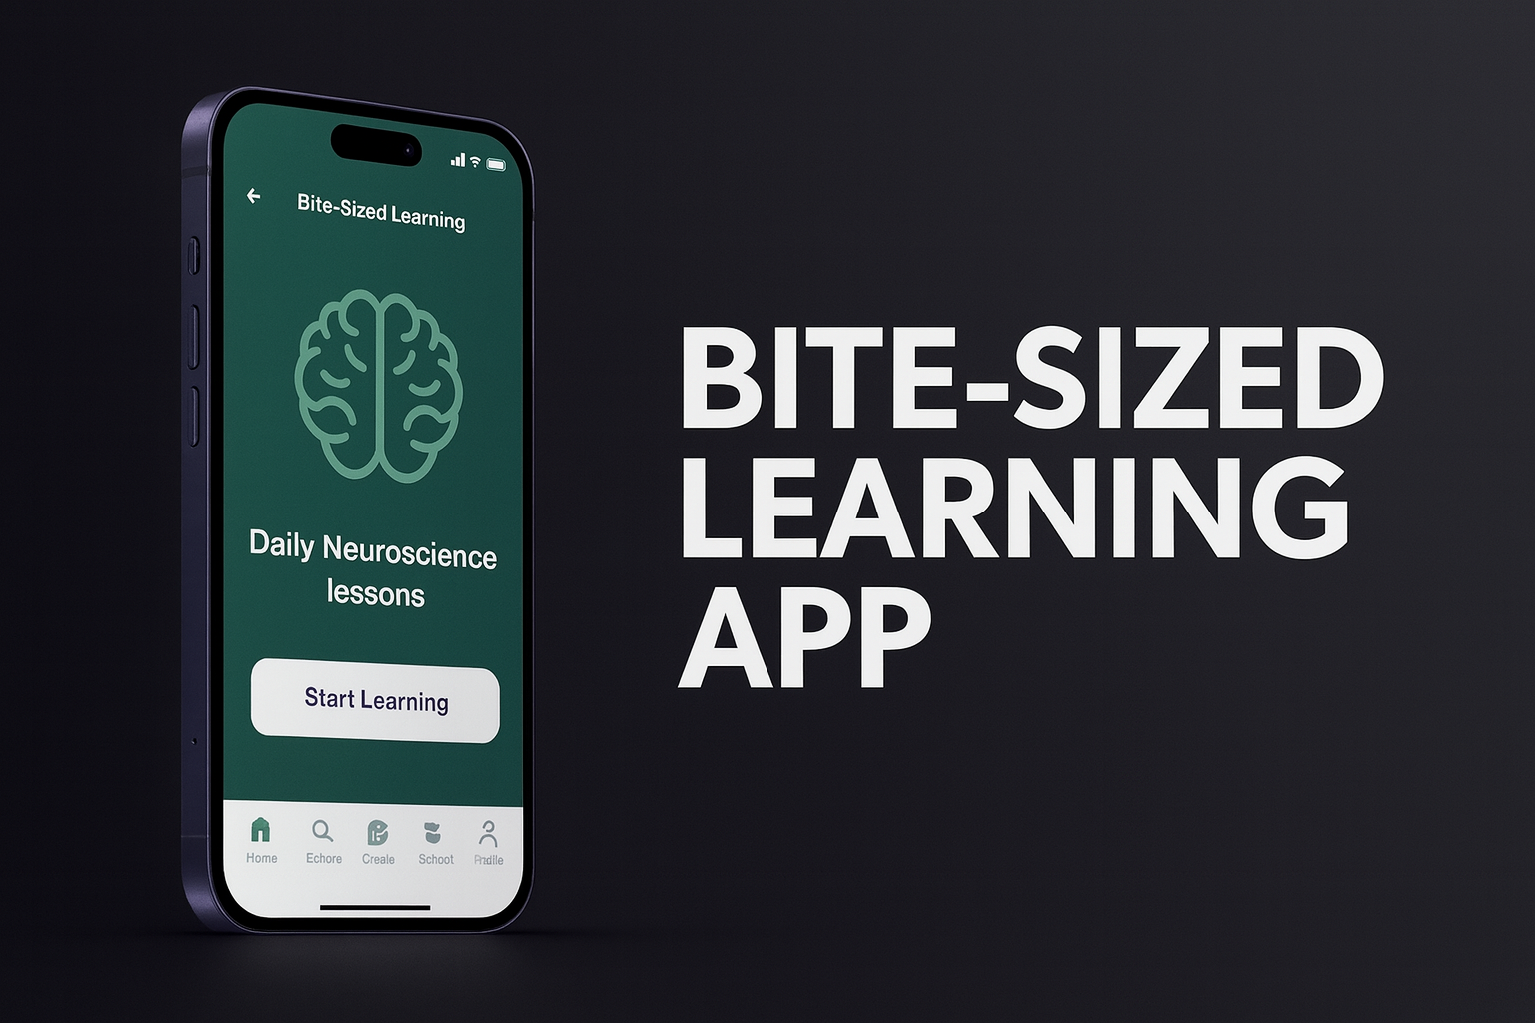
Problem Statement 1
By:
Dhruv Dwivedi
Aadya Srivastava

Slide 2
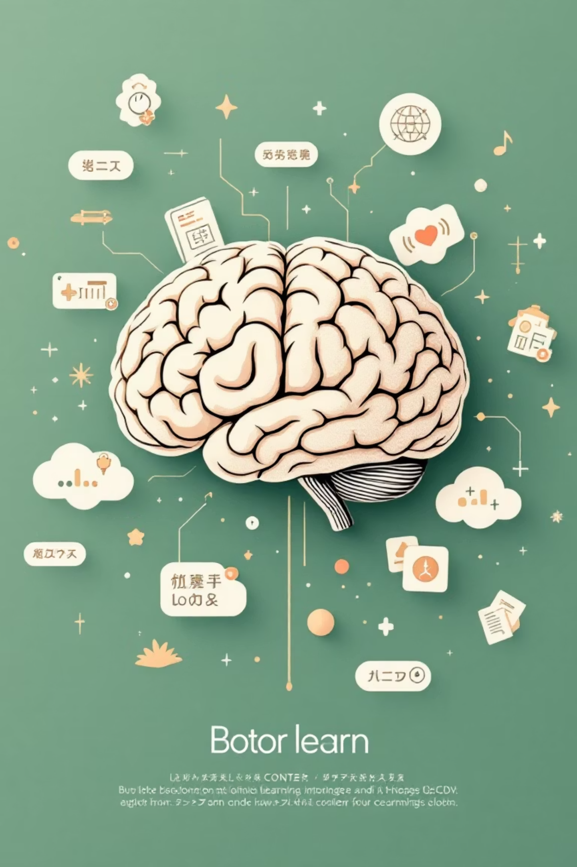
MicroMint
Learn Anything in Under 60 Seconds
MicroMint redefines learning, offering bite-sized knowledge for today's fast-paced world. Dive into AI-powered summaries, personalized micro-courses, and engaging content designed for ultimate retention.

Slide 3


The Problem: Information Overload
Lengthy & Overwhelming Content
Traditional educational platforms often present content that is too long, leading to learner fatigue and disengagement.
Busy Learners Abandon Longer Videos
In our fast-paced world, learners struggle to commit to long-form content, often abandoning courses before completion.
Short-Form Lacks Structure
While short-video platforms are engaging, they typically lack the structured learning paths necessary for true comprehension.
Low Attention & Completion Rates
The result is a widespread issue of dwindling attention spans and low completion rates across educational content.

Slide 4



Our Target Users
Students
Working Professionals
Creators
Seeking quick concept explanations, efficient revision tools, and supplementary learning materials to ace their studies.
Aiming for rapid upskilling, staying current with industry trends, and acquiring new competencies without disrupting their busy schedules.
Looking for intuitive tools to simplify content creation, build structured micro-courses, and monetize their expertise effectively.

Slide 5

Identifying the Market Gap
Reels/Shorts: Engaging but Unstructured
Udemy/Coursera: Structured but Too Long
The Missing Piece: Micro-Learning & Structured Curriculum
These platforms excel at capturing attention but fail to provide a cohesive, progressive learning experience.
While comprehensive, their long-form courses don't cater to the demand for quick, digestible knowledge.
There's no existing platform that seamlessly blends the engagement of short videos with a structured, curriculum-based approach to micro-learning. Until now.

Slide 6

Our Solution: MicroMint
30–90 Sec Micro-Videos
Concise, impactful video lessons designed for maximum retention in minimal time.
AI-Assisted Micro-Courses
Structured learning paths, intelligently designed and supported by AI for efficiency and engagement.
AI-Powered Feed Personalization
Content tailored to your interests and learning style, ensuring relevant and captivating material always.
AI Summaries, Quizzes & Flashcards
Reinforce learning with instant, AI-generated tools that make revision effortless and effective.

Slide 7





Key Features for Learners
Personalized Feed
Content curated just for you, matching your interests and learning pace.
Gamified Streaks
Stay motivated with rewards and challenges, making learning a fun habit.
Micro-Courses (<10 mins)
Master new skills in minutes, perfectly suited for busy schedules.
Save-to-Playlist
AI Flashcards & Quizzes
Organize and revisit your favorite lessons effortlessly.
Reinforce knowledge with smart, adaptive review tools.

Slide 8

Key Features for Creators
Upload Short Videos
1
Share your expertise in concise, impactful video segments.
Smart Tagging
2
AI-powered tags ensure your content reaches the right audience.
Instant Micro-Course Builder
3
Assemble your videos into structured courses with ease.
AI-Generated Titles & Quizzes
4
Automate content enhancement and assessment creation.
Analytics Dashboard
5
Track performance and audience engagement with comprehensive insights.

Slide 9

User Flow: The Learner's Journey
Select Interests
Watch Micro-Videos
Join Micro-Courses
1
2
3
Select Interests
Watch Micro-Videos
Join Micro-Courses
Begin by choosing topics you're passionate about to tailor your learning experience. This populates your personalized feed.
Engage with bite-sized video lessons on demand. Discover new subjects and add valuable content to your personal playlist.
Enroll in structured micro-courses to deepen your knowledge, track your progress, and master new skills efficiently.

Slide 10

User Flow: The Creator's Journey
Upload Video
Tag Content
Add & Publish
AI Optimize
Upload
Tag
Seamlessly upload your short educational videos to the platform.
Effortlessly tag your content using our smart suggestions for discoverability.
AI Optimize
Add to Micro-Course & Publish
Let AI enhance your videos, suggesting improvements for engagement and reach.
Integrate content into courses and launch them to a global audience.

Slide 11





The Power of AI
AI Feed Personalization
Dynamically adapts content suggestions based on user behavior and preferences, making every learning path unique.
AI Quiz Generator
Automatically creates engaging quizzes from video content, testing comprehension and reinforcing key concepts.
AI Auto-Summary
Generates concise summaries of micro-videos, enabling quick review and efficient knowledge recall.
AI MicroTutor
An intelligent virtual assistant that provides instant answers, clarifications, and further explanations on demand.

Slide 12
Thank You!

